Slide 1

PASSIVE COOLING FOR HOMES
KNOWLEDGE INSTITUTE OF TECHNOLOGY

Slide 2
PASSIVE COOLING FOR HOMES
KNOWLEDGE INSTITUTE OF TECHNOLOGY
Passive Cooling for Homes is an energy-efficient and sustainable solution designed to reduce indoor temperature without depending on conventional air-conditioning systems. The project utilizes passive cooling techniques such as reflective roofing, thermal insulation, natural ventilation, and shading to improve indoor thermal comfort.
An ESP32-based monitoring system with DS18B20 temperature sensors continuously records indoor and outdoor temperatures, enabling performance analysis and validation of the cooling effectiveness.

Slide 3
Double Content Slide
KNOWLEDGE INSTITUTE OF TECHNOLOGY
Technical Architecture Our system
The prototype consists of a residential house model constructed using thermally stable materials. It incorporates reflective roof surfaces, thermocol insulation, strategically placed ventilation openings, and shading elements. Two DS18B20 temperature sensors connected to an ESP32 microcontroller monitor indoor and outdoor temperatures. A DS3231 RTC module provides time synchronization, while an SD card module stores temperature data for analysis.
User Value & Impact
The system offers a low-cost, environmentally friendly alternative to conventional cooling systems. It reduces electricity consumption, minimizes greenhouse gas emissions, and improves thermal comfort. The design is especially suitable for tropical regions, rural housing, and sustainable residential applications.

Slide 4
Bulleted List Slide
KNOWLEDGE INSTITUTE OF TECHNOLOGY
Passive cooling without air conditioning
Natural ventilation for heat dissipation
Reflective roofing reduces solar heat absorption
Thermal insulation minimizes heat transfer
Low energy consumption
Eco-friendly and sustainable design
Real-time temperature monitoring using ESP32
Suitable for tropical and high-temperature regions

Slide 5
Comparison Slide
KNOWLEDGE INSTITUTE OF TECHNOLOGY
Compare Section
Contrast Section
Like conventional cooling systems, the Passive Cooling System improves indoor thermal comfort by lowering room temperature and maintaining a more stable indoor environment. It enhances occupant comfort during hot weather conditions.
Unlike air conditioners, this system consumes little to no electrical energy for cooling and does not use refrigerants. It combines reflective materials, insulation, and natural ventilation to provide a cost-effective and sustainable cooling solution with significantly lower operating costs.

Slide 6
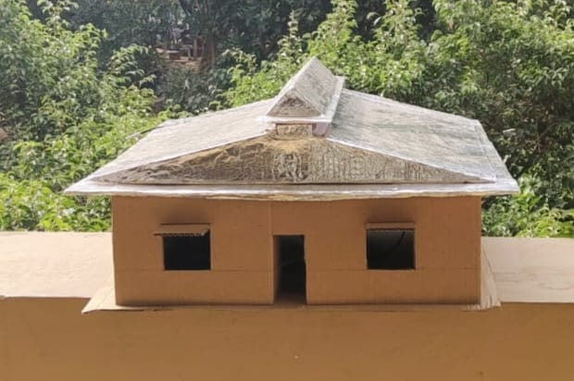
Prototype
KNOWLEDGE INSTITUTE OF TECHNOLOGY
The developed prototype demonstrates a small-scale residential building model integrated with passive cooling elements. Reflective roofing minimizes heat absorption, thermocol insulation reduces conductive heat transfer, and ventilation openings facilitate natural airflow. Temperature sensors continuously measure indoor and outdoor conditions to validate the effectiveness of the passive cooling techniques implemented in the prototype.
.

Slide 7
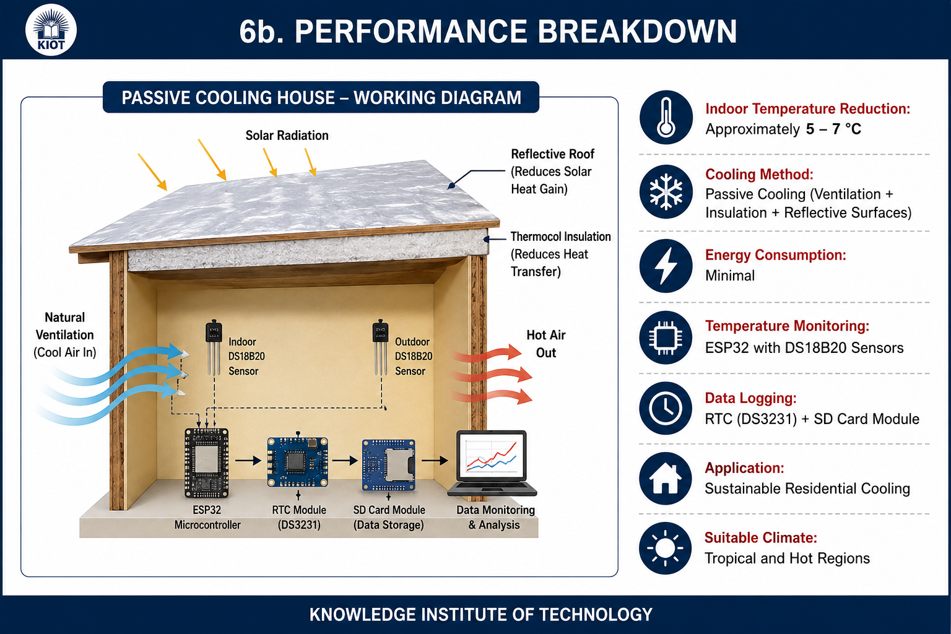
Performance breakdown
KNOWLEDGE INSTITUTE OF TECHNOLOGY
Indoor temperature reduction: Approximately 5–7°C
Cooling method: Passive cooling (ventilation + insulation + reflective surfaces)
Energy consumption: Minimal
Temperature monitoring: ESP32 with DS18B20 sensors
Data logging: RTC + SD Card Module
Application: Sustainable residential cooling
Suitable climate: Tropical and hot regions

Slide 8
CONCLUSION
KNOWLEDGE INSTITUTE OF TECHNOLOGY
COOLING HOMES, SAVING ENERGY
The Passive Cooling System for Homes demonstrates that indoor thermal comfort can be achieved through simple engineering principles and sustainable design techniques. By combining reflective roofing, thermal insulation, natural ventilation, and real-time temperature monitoring, the system effectively reduces indoor temperature while minimizing energy consumption. This project provides a practical, economical, and environmentally responsible solution for residential buildings in hot climatic regions.

